Slide 1

Advanced Computer Vision
Jia-Bin Huang
Electrical and Computer Engineering
Virginia Tech

Slide 2
Today’s class
A little about me
A little about you
Course logistics
Topic overview

Slide 3

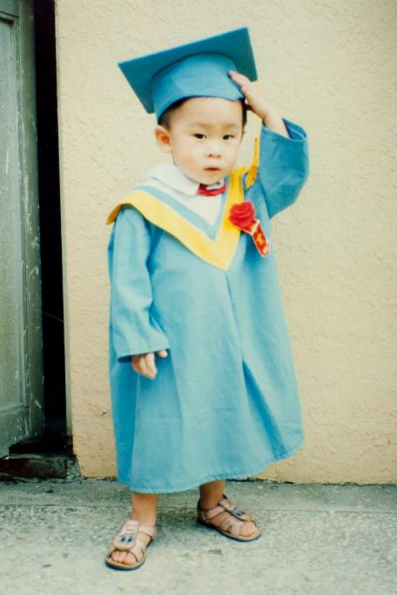
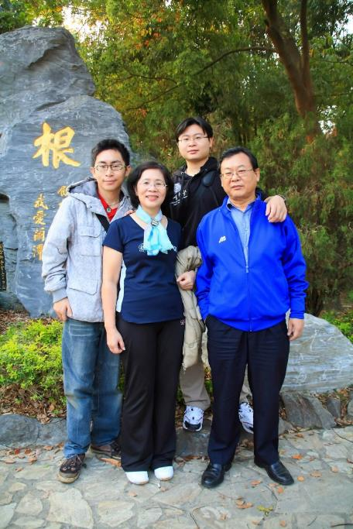


About me
7 months old!

Slide 4
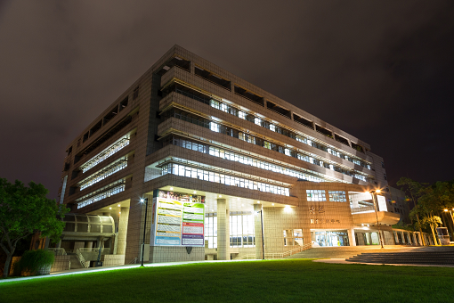


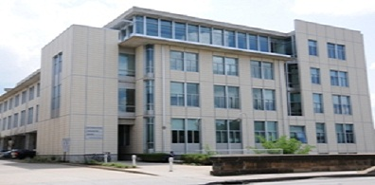
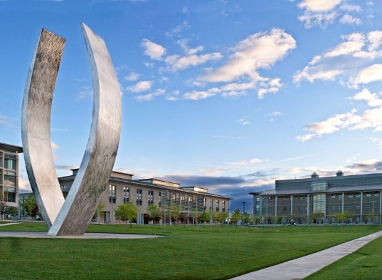
National Chiao-Tung University
B.S. in EE
Microsoft Research
Research Intern
2012, 2013
IIS, Academia Sinica
Research Assistant
Disney Research
Research Intern 2014
UC, Merced
Visiting Student
UIUC
Ph.D. in ECE 2016

Slide 5
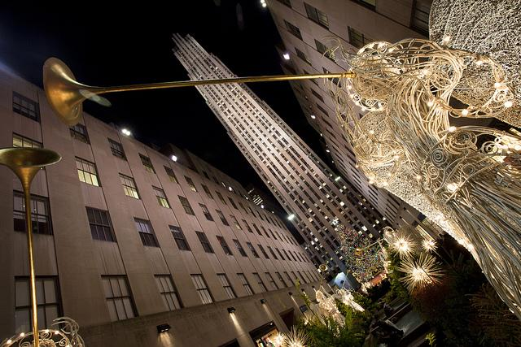
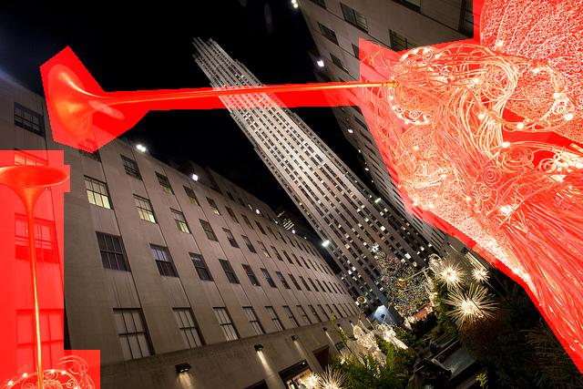
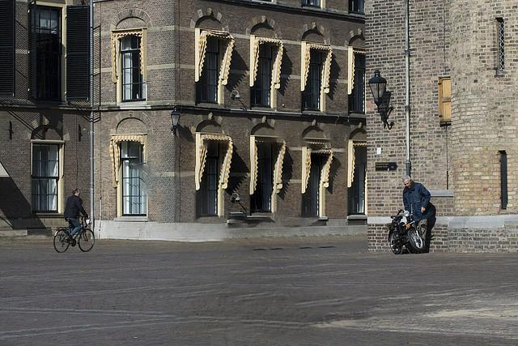


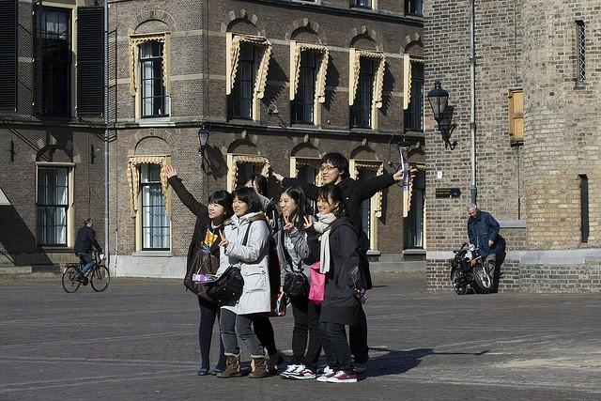
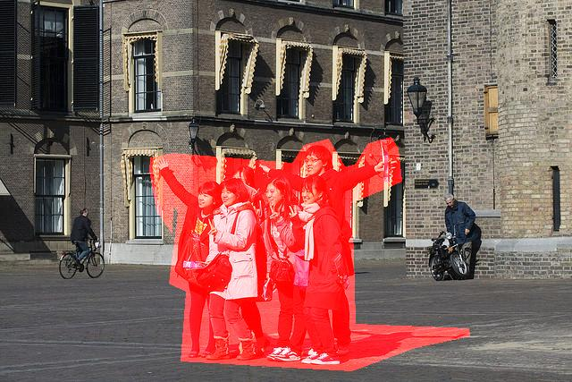

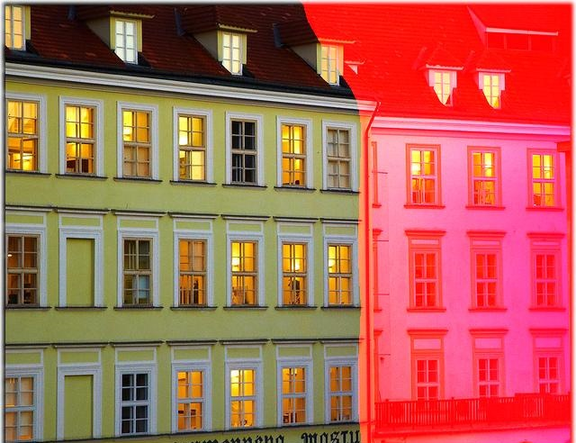
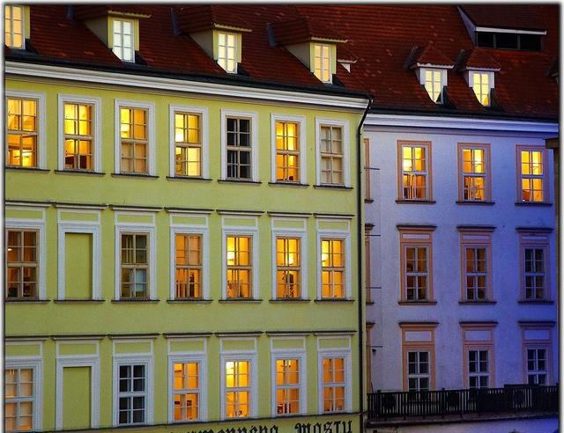

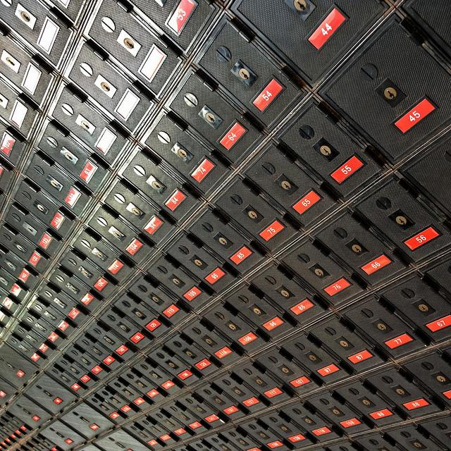
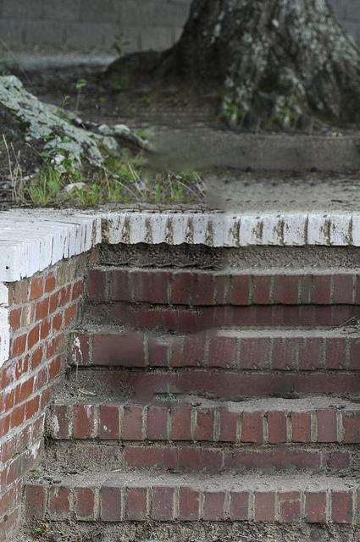
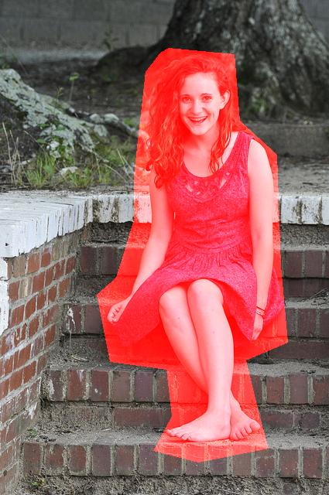

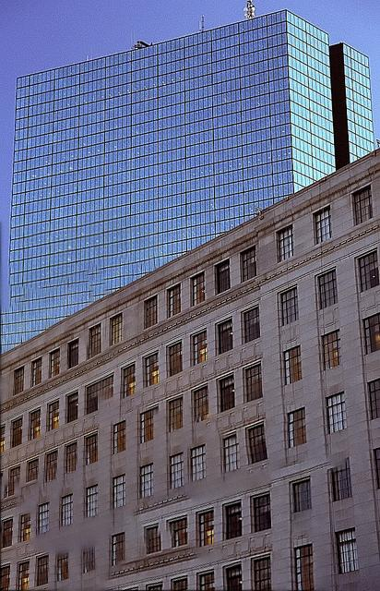
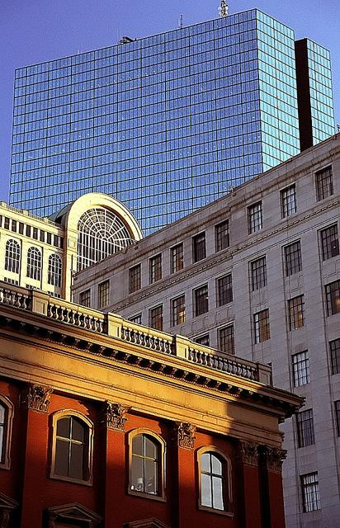







Image Completion [SIGGRAPH14]
- Revealing unseen pixels
Notes:
Thanks for your attention!

Slide 6
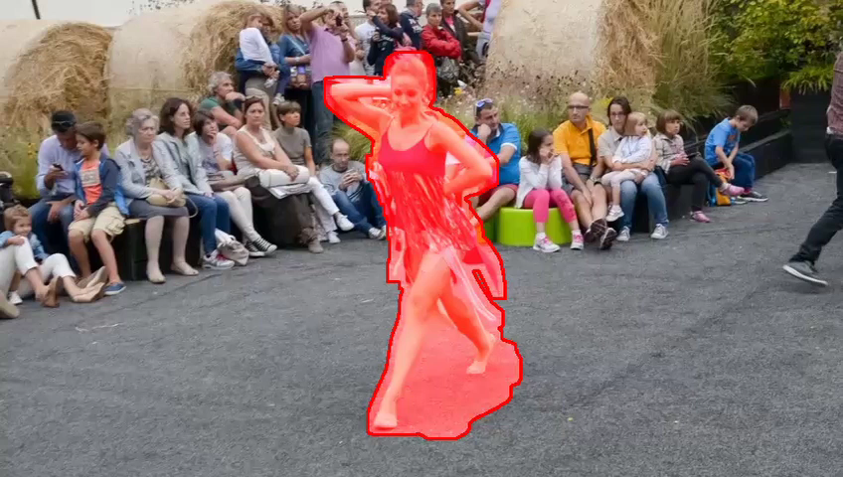
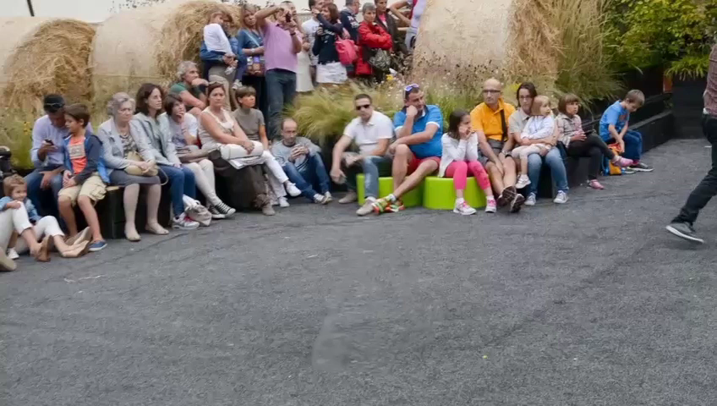
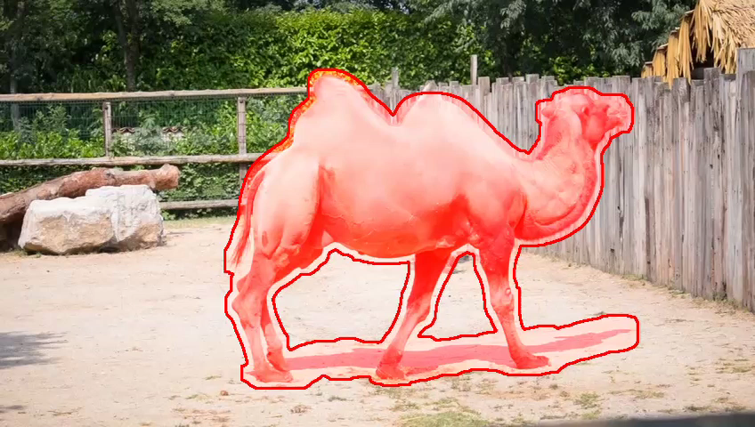
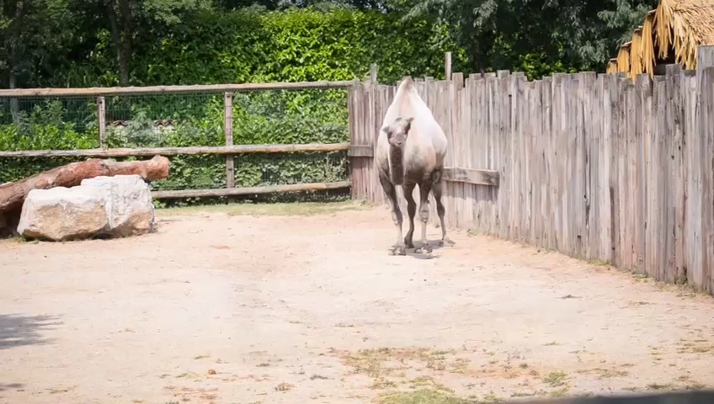
Video Completion [SIGGRAPH Asia16]
- Revealing temporally coherent pixels

Slide 7


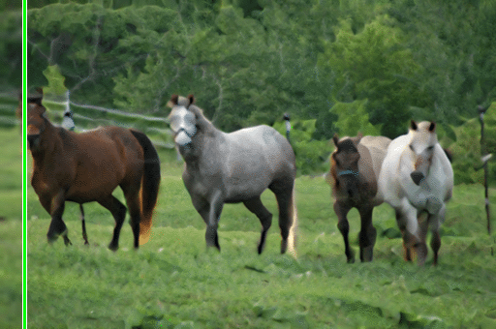


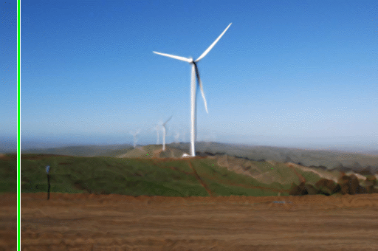



Image super-resolution [CVPR15]
  - Revealing unseen high frequency details

Slide 8
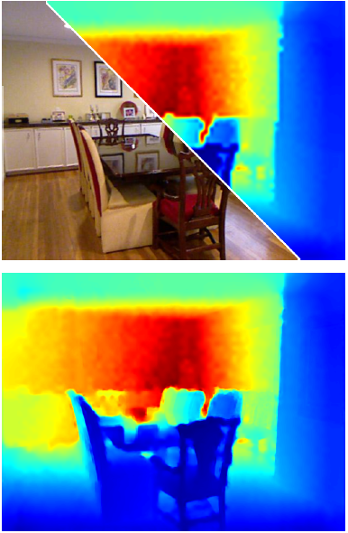
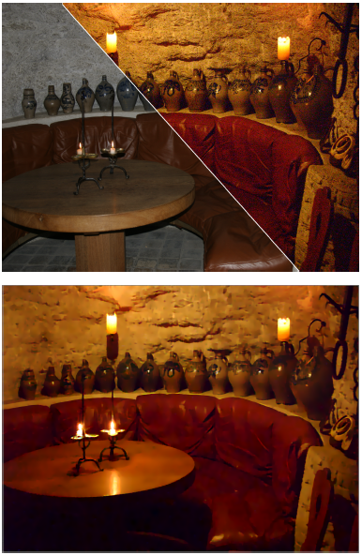
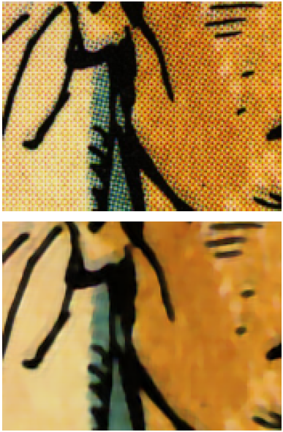
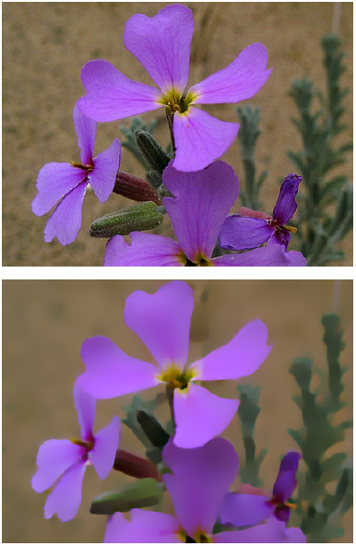
Depth upsampling
Noise reduction
Inverse halftoning
Texture removal
Deep Joint Image Filtering [ECCV16]
  - Transferring structural details

Slide 9
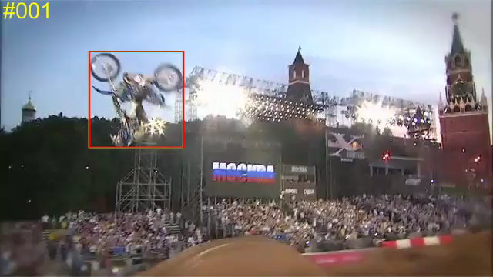
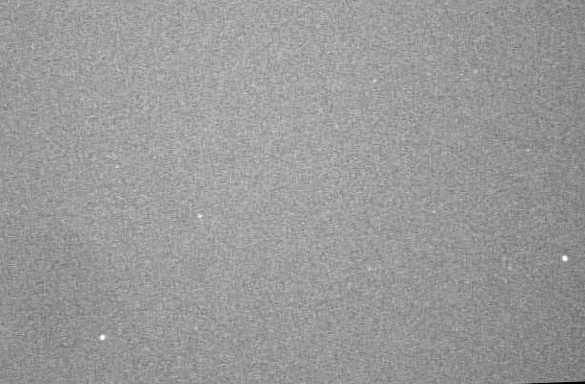
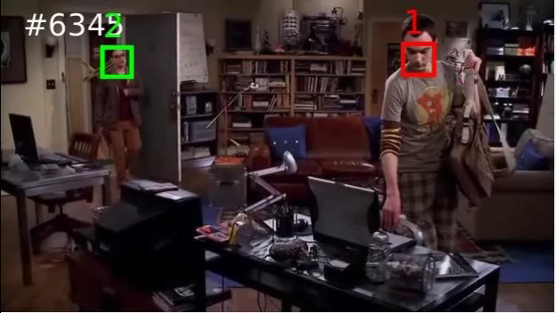
Object tracking [ICCV15]
Detecting migrating birds [CVPR16]
Visual Tracking
- Locating moving objects across video frames
Multi-face tracking [ECCV16]

Slide 10
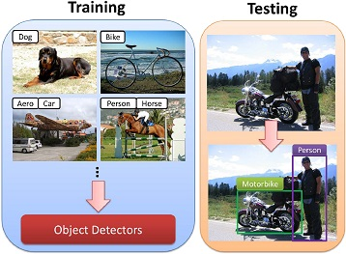
Unlabeled images
k-NN Graph
Positive mining
Negative mining
Weakly supervised localization [CVPR16]
Learning with weak labels
Unsupervised feature learning [ECCV16]

Slide 11
A little about you
Find a partner.
Introduce yourself
  Name?
  Department?
  Why are you taking this course?
  One interesting fact?
3 mins
Introduce your partner!

Slide 12
Course Overview
ECE 6554
  Tuesday and Thursday 2:00 pm to 3:15 pm
  Randolph Hall 220
Office hours (Jia-Bin)
  TBD (will post a doodle link on piazza)
Course webpage: http://bit.ly/vt-computer-vision-spring-2017
Piazza discussion forum: http://piazza.com/vt/spring2017/ece6554

Slide 13
This course
Focus on more advanced techniques and ideas in computer vision
Presented in research papers
High-level recognition problems, innovative applications.

Slide 14
Goals
Understand state-of-the-art approaches
Analyze and critique current approaches
Identify interesting open questions
Present clearly and methodically

Slide 15
Expectations
[5%] Class participation
[25%] Paper reviews
[10%] Leading discussions
[20%] Topic presentation
[10%] Experiment presentation
[30%] Final project

Slide 16
Requirements – Class participation
Read the assigned papers before each class
Actively participate in discussions in class.
If you are unable to attend a specific class, please let me know ahead of time via email (and have a good excuse).
No laptops, cell phone or other distractions in class please.

Slide 17
Requirements – Paper reviews
One page review of the selected paper
Write in your own words
Due date
  12:00 PM (noon) the day of the class (i.e. on Tuesdays and Thursdays).
Submission via piazza
Skip the review if
  You are presenting a paper on that day
  You are a discussion lead on that day

Slide 18
Paper reviews – Suggested structure
Short summary of the paper
Main contributions
Strengths and weaknesses?
Are the experiments convincing?
How could the work be extended?
Additional comments, including unclear points, open research questions, and applications.

Slide 19
Requirements – Leading discussions
~ One of you will be assigned to argue for the paper
~ One of you will be assigned to argue against the paper
Come prepared with 5 points

Slide 20
Requirements – Topic presentation
30 minutes in-class presentation
Meet with me 3 days prior the talk (i.e. Mon/Friday)
with a complete set of slides for a dry run
IMPORTANT: Don’t present papers – present the topic!

Slide 21
Topic presentation - Structure
High-level topic overview
Main motivation
Clear statement of the problem
Overview of the technical approach
Strengths/weaknesses of the approach
Overview of the experimental evaluation
Strengths/weaknesses of evaluation
Discussion: future direction, links to other work

Slide 22
Requirements – Experiment presentation
15 minutes in-class presentation
Send the draft to me 3 days prior your talk
Implement/download code for a main idea in the paper and evaluate it:
  Experiment with different types of training/testing data sets
  Evaluate sensitivity to important parameter settings
  Show an example to analyze a strength/weakness of the approach
  Show qualitative and quantitative results

Slide 23
Requirements – Final project
Possibilities:
  Extension of a technique studied in class
  Analysis and empirical evaluation of an existing technique
  Comparison between two approaches
  Design and evaluate a novel approach
  Be creative!
Work individually or in pair
Computational resources: http://www.arc.vt.edu/

Slide 24
Requirements – Project tentative timeline
Project proposals (1 page) [10%]
  March 2nd
Final project presentations [40%]
  10-mins in-class presentation
  May 4 to 8
Final project report [50%]
  6-8 pages research paper
  May 8

Slide 25
Each Lecture
~ 15 minute discussion on paper we read
  Led by two students: “for” and “against”
~ 30 minute presentation on topic
~ 15 minute presentation on experiment
~ 15 minutes for questions, interruptions, unplanned discussions

Slide 26
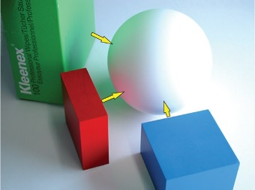
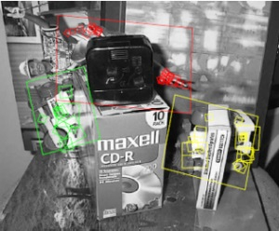
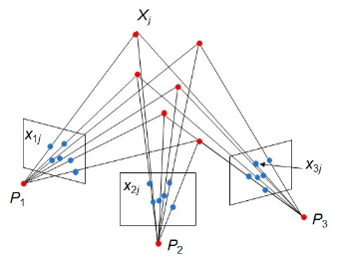
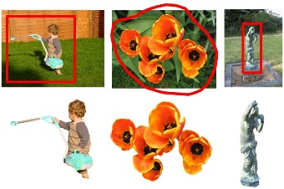

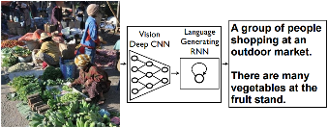
Computer Vision Fundamentals
Interpreting Intensities
  What determines the brightness and color of a pixel?
  How can we use image filters to extract meaningful information from the image?
Correspondence and Alignment
  How can we find corresponding points in objects or scenes?
  How can we estimate the transformation between them?
Perspective and 3D Geometry
  How can we map between the 3D world and the 2D image?
  How can we recover 3D coordinates from images or video?
Grouping and Segmentation
  How can we group pixels into meaningful regions?
Categorization and Object Recognition
  How can we represent images and categorize them?
  How can we recognize categories of objects?
Advanced Topics
  Action recognition, 3D scenes and context, CNNs, …

Slide 27
Major topics in this class
Visual Recognition
  Instance/category recognition, ConvNets, detection, segmentation, pose
Representation Learning
  Attributes, self-supervised learning, generative models, image styles
Activity and Event
  Action recognition, active perception, object relationships, first-person
Multi-modality
  Language, sketches, sounds
Applications and Data
  Robotics, graphics, big data, human-in-the-loop, crowdsourcing

Slide 28
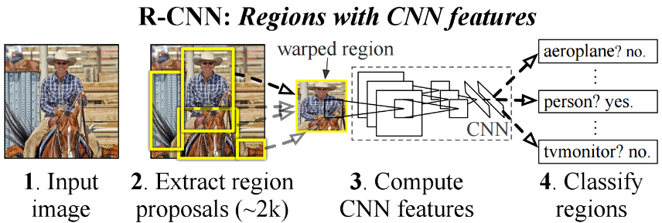
RCNN [Girshick et al. CVPR 2014]

Slide 29
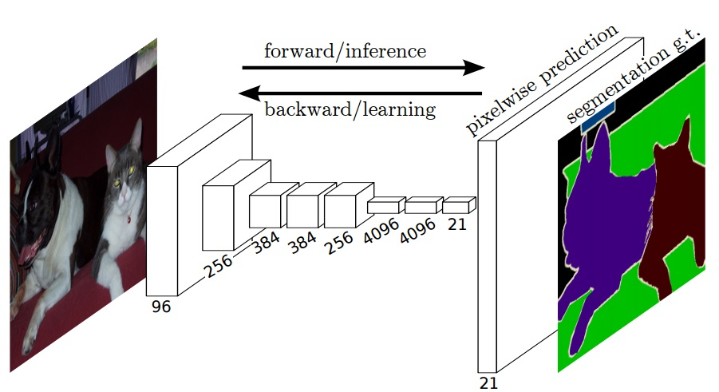
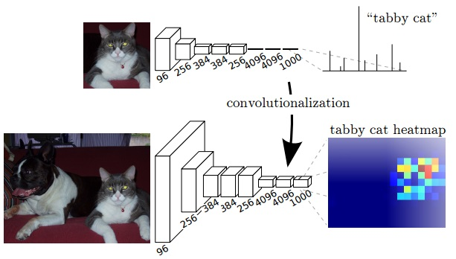
Fully Convolutional Networks for Semantic Segmentation [Long et al. CVPR 2015]

Slide 30
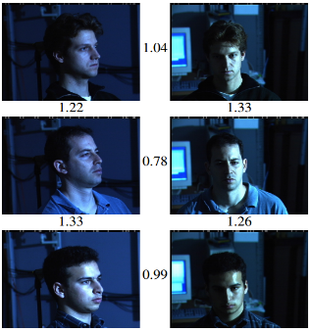
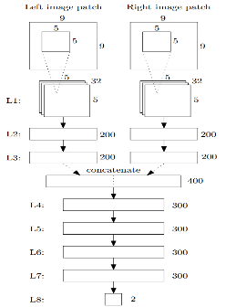
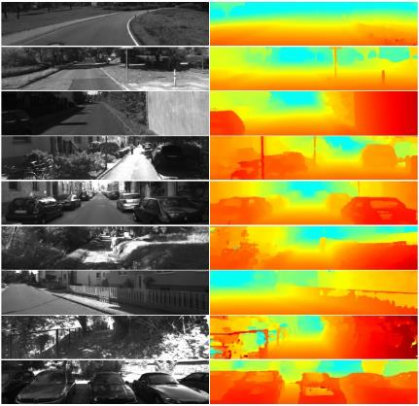
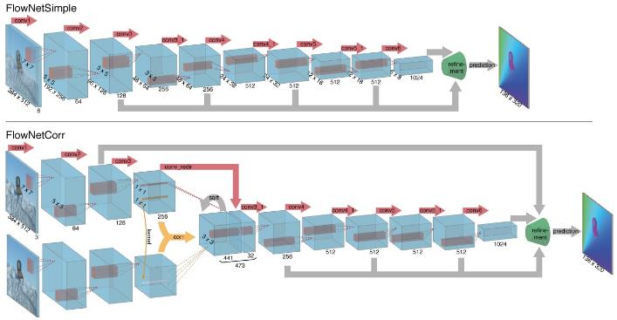
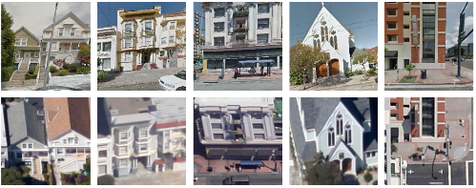
CNN as a Similarity Measure for Matching
Stereo matching [Zbontar and LeCun CVPR 2015]
Compare patch [Zagoruyko and Komodakis 2015]
FaceNet [Schroff et al. 2015]
Match ground and aerial images
[Lin et al. CVPR 2015]
FlowNet [Fischer et al 2015]

Slide 31
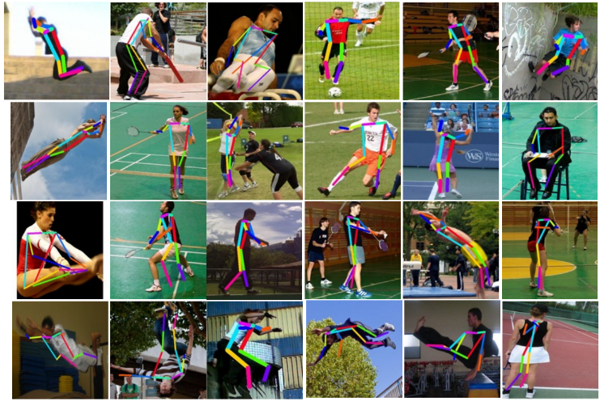
DeepPose [Toshev and Szegedy CVPR 2014]

Slide 32
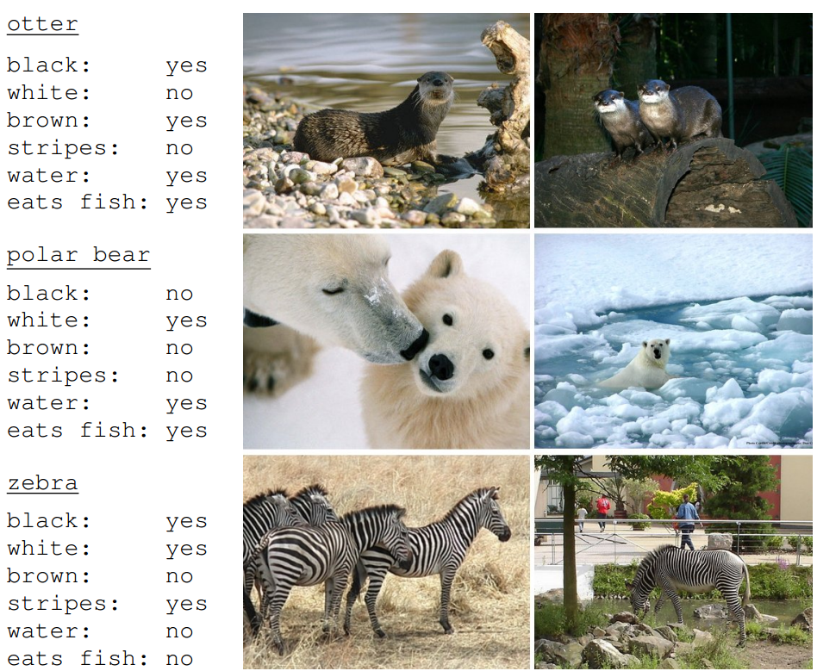
Learning To Detect Unseen Object Classes by Between-Class Attribute Transfer. [Lampert et al. CVPR 2009]

Slide 33
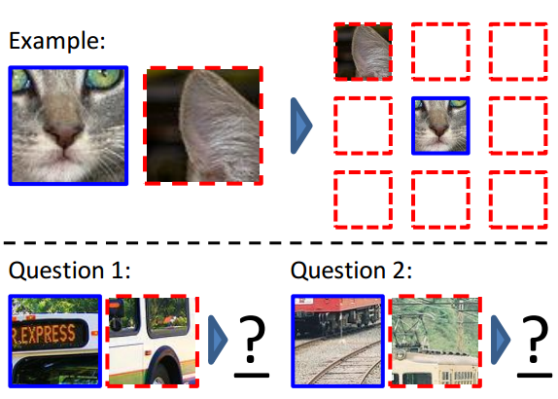
Context Prediction [Doersch et al. ICCV 2015]

Slide 34
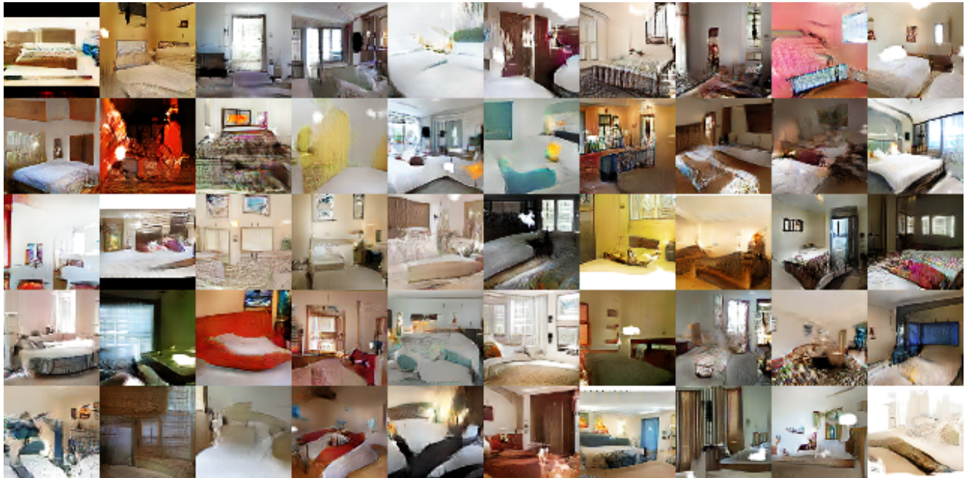
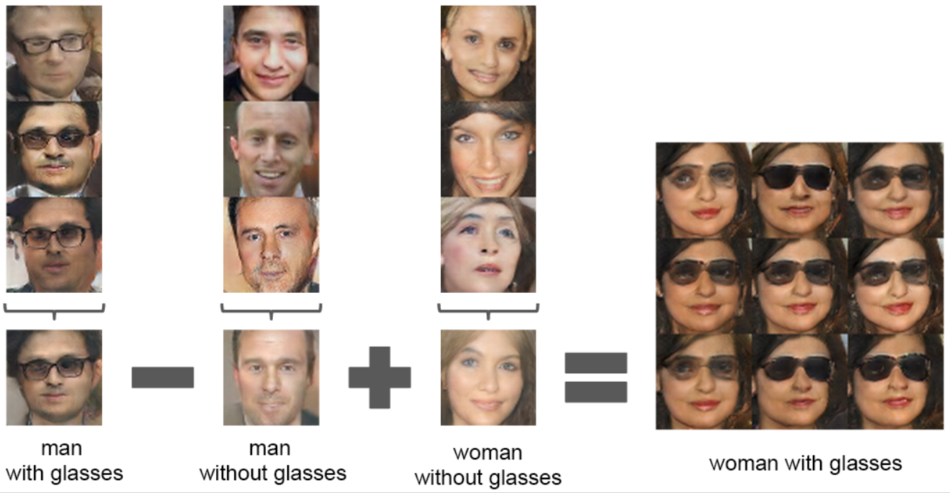
[Radford et al. ICLR 2016]

Slide 35
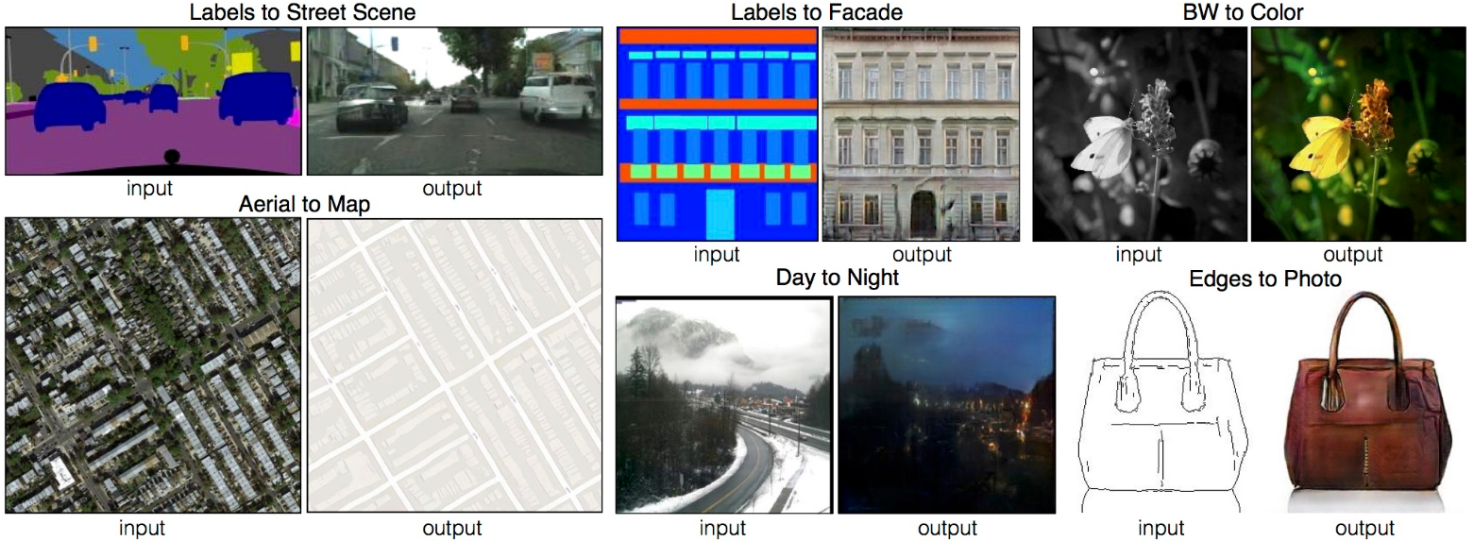
[Isola et al. 2016]

Slide 36

[Gatys et al. CVPR 2016]

Slide 37

Action recognition

Slide 38

Active Perception

Slide 39

Groups of Objects

Slide 40

First-person vision

Slide 41

Language and vision

Slide 42

Sketches

Slide 43

Cross-modal learning

Slide 44


Getting help outside of class
Discussion Board:
http://piazza.com/vt/spring2017/ece6554
Readings/Textbook:
http://szeliski.org/Book/
Lecture notes: will be posted online
Use Office Hours / After class

Slide 45
Things to remember
To-Do
  Sign up piazza discussion board
  Sign up topics you would like to present/discuss/experiment
  Submit your paper review via piazza
Next class: Instance recognition
Questions?

